Slide 1
Stony Brook University
Master of Science in Accounting

Slide 2
Stony Brook University
State University of New York (SUNY) at Stony Brook
百度百科：
纽约州立大学石溪分校（Stony Brook University，简称SBU），又称石溪大学，坐落于纽约市郊风景区长岛，是美国著名的研究型公立大学，在世界范围内享有很高的学术声誉。石溪大学是北美顶尖大学联盟美国大学协会（AAU） 的62个成员之一，享有公立常春藤的美誉。
卡内基基金会（Carnegie Foundation）将石溪分校列为全美最优秀的研究机构之一，约翰∙霍普金斯大学（Johns Hopkins University）亦十分推崇石溪分校在学术研究方面的成果，根据该校的排名，石溪分校名列全美公立大学第二名，仅次于加州大学伯克利分校。
石溪大学拥有许多一流学者，其教学品质和研究成果享誉国际，石溪的教授队伍中聚集着各领域的顶尖研究人员，著名核物理学家、诺贝尔物理奖获得者杨振宁在该校执教37年。世界上第一张核磁共振图像诞生于此。自1957年成立后，已经培养出多位著名人物，包括3位诺贝尔奖得主及菲尔茨奖、沃尔夫奖和阿贝尔奖得主约翰·米尔诺等。

Slide 3
Stony Brook University
Other AAU members in New York: Cornell University, New York University, Columbia University, University of Rochester, SUNY at Buffalo

Slide 4
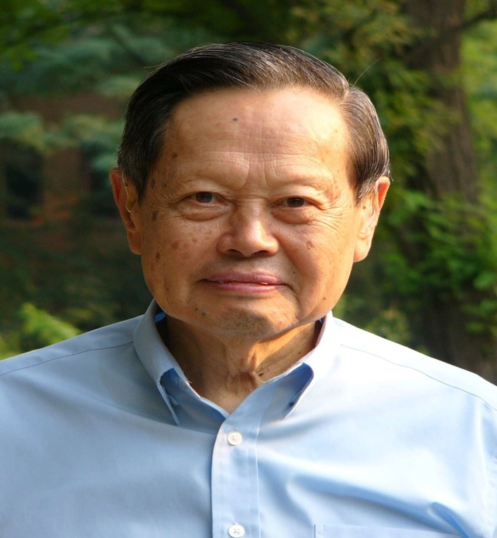
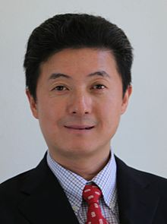
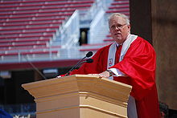
Notable People
杨振宁
丘成桐
John Hennessy
President of Stanford University
张首晟

Slide 5
Location, Location, and Location!
Stony Brook University is located in Long Island, New York
A part of the metropolitan region of New York City (NYC) , the world’s financial and cultural capital
Big 4 audit firms are all headquartered in NYC, so are top investment banks and many other financial institutions

Slide 6
Location, Location, and Location!
ALL of YOU have been to Long Island：20世纪美国最伟大的小说《The Great Gatsby》以及情景喜剧《Growing Pains》描述的故事、影视取景，都发生在纽约长岛

Slide 7
Location, Location, and Location!
Long island：风水宝地，名人荟萃
宋美龄故居

Slide 8
Location, Location, and Location!
Long island: beautiful natural landscape and four distinct seasons

Slide 9
Location, Location, and Location!
重要的是：你可以吃到各种地道的中华美食，即使你身在异国他乡！大纽约地区有多达百万的华人。

Slide 10
Master of Science in Accounting
Required Courses
I. Fall Semester | Leadership, Team Effectiveness & Communications Financial Accounting Theory Advanced Auditing & Assurance Government & Non-Profit Accounting Forensic Accounting
II. Spring Semester | Ethics and Law Federal Income Tax Corporate Governance Financial Statement Analysis and Firm Valuation Accounting Capstone (CPA Material)
You will qualify to take the Uniform Certified Public Accounting (CPA) examination, and ultimately become a licensed CPA in New York State, after successfully completing your study.

Slide 11
Master of Science in Accounting
Admission requirements
Major in accounting or auditing during undergraduate study
GPA 3.2/4
TOEFL 85 or IELTS 6.5
GMAT 550
We may waive the GMAT requirement for applicants with a GPA of 3.5 or better.
Tuition: around $27,000
Interested students can send transcripts and English test score reports to Dr. Zhifeng Yang (zhifeng.yang@stonybrook.edu) for a preview.

